Slide 1
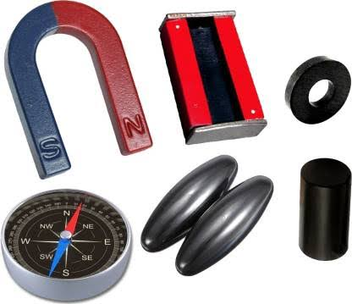
FUN WITH MAGNETS

Slide 2
Jack was a small boy who lived in Norway. One day when he was roaming around his place suddenly he lost his way to his house and started crying. Suddenly he found a man who was crossing him. At once Jack called the man and asked for help. The man agreed to help him. He asked Jack to give some landmarks to identify his house. Jack gave some landmarks where the man told that Jack’s house was in the northern direction from there. The man had a small dial where, there was a needle inside it and it was rotating freely. The man dropped Jack to his house and started moving from there. Jack was surprised and had a questions in his mind,” Is that a magic dial, which showed the way to my home!?”.

Slide 3
Topics
What is a magnet?
Poles of magnet
The Earth’s Magnetism
Making Magnet
Magnetic Field
Uses of Magnets

Slide 4
https://youtu.be/Eg5iloWP-WI
History of Magnet.

Slide 5
Terminology:
Magnetite: The black rock that attracts Iron.
Lodestone: Means ‘leading stone’ shows the direction. It suspends in North-South direction.
Magnet: Any material that has the property of attracting iron.
Magnetism: The natural magnet that has a attracting property.
Magnetic force: The force that the magnet exerts on iron.

Slide 6
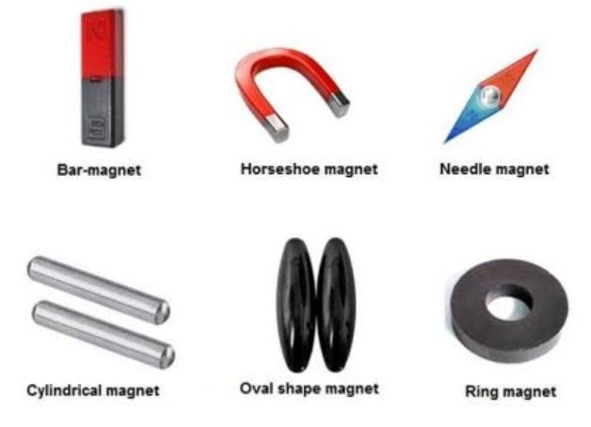
Shapes of Magnet:
Magnets are mostly of two types they are bar magnet and horseshoe magnet.
Types of substances:
Magnetic and Non-Magnetic substance.
Magnetic substance: Substance that get attracted towards the magnet.
Non-magnetic substance: Substance that doesn’t get attracted to the magnet.

Slide 7
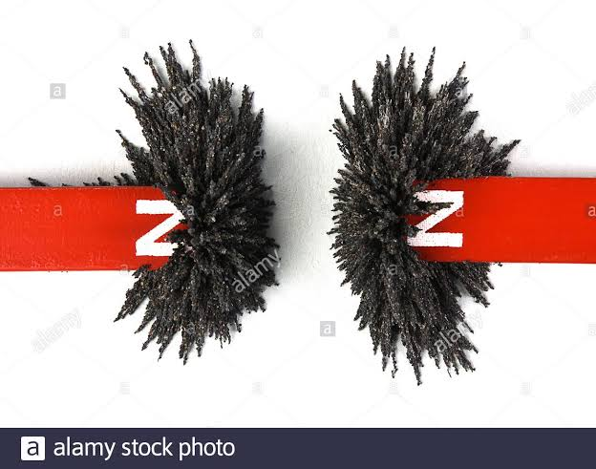
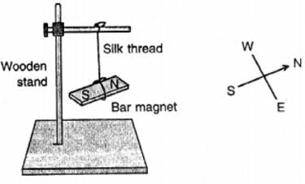
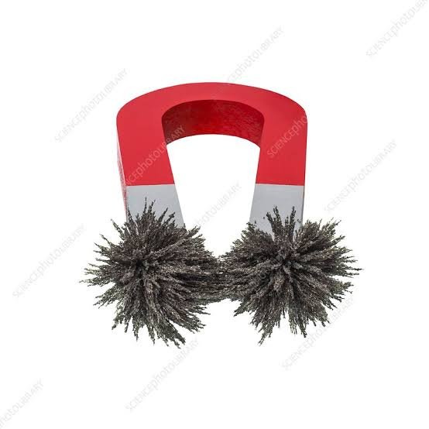
Poles of magnet
In the Bar or Horseshoe magnet the iron filling are attracted only to the poles, this shoes that the magnetic force or the magnetism is more in the poles.
There are two poles in a magnet – North and South pole.
How to identify the poles?

Slide 8
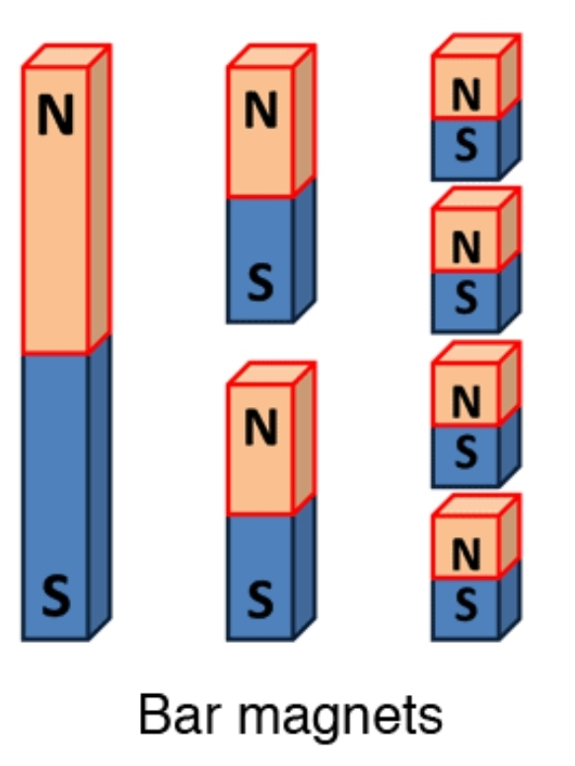
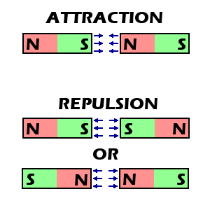
Can magnetic poles be Isolated? Attraction and Repulsion
No…. Unike poles attract and. . Like poles repel

Slide 9
Today’s Assignment:
I. Give one word answer.
Like poles_____ and unlike poles _____.
Can a magnetic North poles exist without the magnetic south pole.
Can we make a magnet with only one pole? True or false.
II. Answer in short.
Why a freely suspended magnet point in the North-South direction?
What happens to the poles of a magnet if it is broken into two?
Will a strong magnet attract a piece of copper? Why?
III. Answer in long.
1. How will you experimentally show that there are two regions in a magnet where its magnetic strength is concentrated?

Slide 10
Recap:
Magnetite and lodestone.
Poles of magnet
Attraction and Repulsion of magnet
Topics:
The Earth’s Magnetism
The Magnetic Compass
Making magnet
Magnetic field
Uses of Magnet

Slide 11
https://youtu.be/PcuDZThGZ-k
Earth’s magnetism:

Slide 13
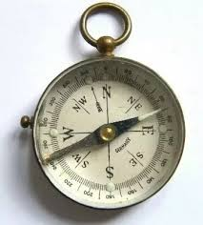
The magnetic compass:
First the magnets are used as compass to find the direction by the sailers..
It has a magnetic needle which is fixed at the centre and rotates freely about that point.
The needle aline itself always in North-South direction provided it is away from any other magnetic materials.

Slide 14
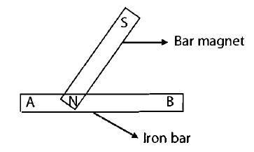
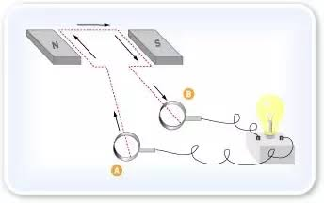
Making magnets: A piece of iron can be magnetized by using a magnet in the following ways 1) Single touch method: 2) Using Electric current: It is no longer used. Now a days magnetsare produced
Youtube video link : https://youtu.be/fHMmNx4AlPg

Slide 15
Demagnetization:
A magnet loses its magnetism.
How???
If is hammered
If the magnet falls from height.
Heating the magnet above a certain temperature.
Storing a magnet:
Self demagnatization – The magnets losses it‘s magnetic power when their poles are left free.
To avoid this bar magnets are kept separated by a piece of wood, with unlike poles alongside each other.

Slide 16
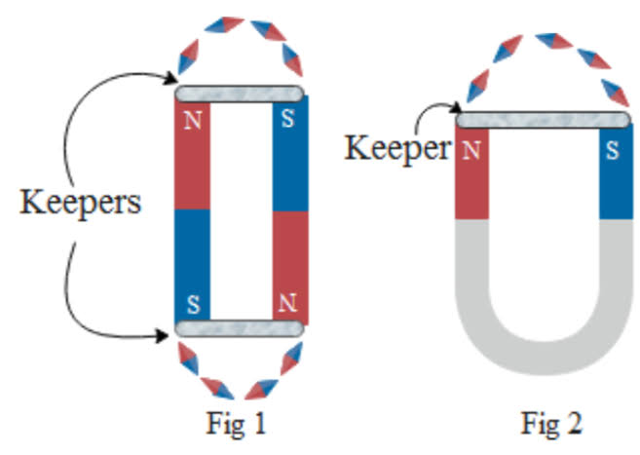
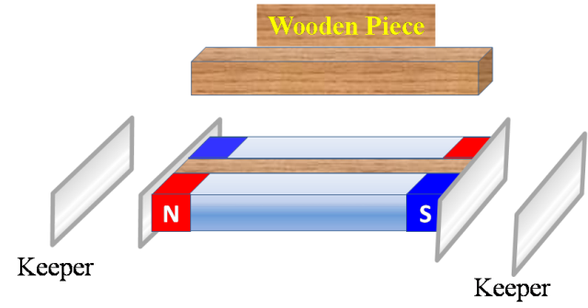
Keepers: Thay are small pieces of iron placed across both ends.
Where the horse shoe magnet needs only one keeper across its poles

Slide 17
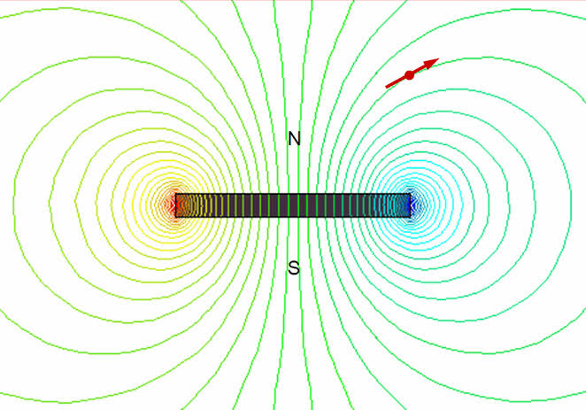
Magnetic field:
Magnetic force acts from a distance.
Some magnetic field passes through space.
Thus the magnetic field reduces as we go further away from the magnet.
When we place the compass near the magnet.
We can see that the needles get deflected due to the effect of magnet.
When we take the needle away away from the magnet their effect reduces
At the end the magnet effect is not felt.

Slide 18
https://youtu.be/NWUgK8W-4JM
Plotting magnetic Field lines

Slide 19
Uses of Magnet.
In refrigerator doors, bulletin boards, toys, etc
Electric bell, electric motors in fans.
Bicycle, Automatic dynamos for making electricity.
Speakers, microphone, pictures tube in television, computer monitors.
Audio tapes, video tapes, computer hard disc, etc

Slide 20
Today’s Assignment:
I. .Answer the questions in short .
1.The earth behaves like a huge bar magnet with its magnetic North Pole near the geographic ________ pole.
2.You are given a piece of iron and a bar magnet. How can you magnetize the piece of iron?
3.The single touch method of making a magnet is extensively used nowadays to make magnets. True or false
4.If a magnet is heated, it can lose its magnetism. True or false
5.The region around a magnet where its magnetic influence can be felt is called it’s magnetic ________.
6.Which instrument, based on a property of magnets, is used to find directions?
7.Iron pieces used for storing magnets are called magnetic _______.
II. Answer in short.
1.State the rule for attraction and repulsion between two magnets
2.One precaution you should always take while handling a magnet is not to drop it. Why?
3. Why are magnetic keepers used to store magnets?
III. Answer in long.
1. Show diagrammatically two ways in which a magnet can be freely suspended to locate direction.
2. Give the step by step method you will adopt to test if a piece of magnetic material is a magnet
3. Given a bar magnet, describe the method you will use to magnetize an iron nail.
4. Name and describe the instrument that uses a magnet to find direction
5. List any three uses of magnet.
IV. Complete the hots questions off your own.

